Slide 1
Drama Therapy
By: Alina Holley

Slide 2
What is Drama Therapy
The use of theatre techniques to facilitate personal growth and promote mental health.
It is a creative arts therapy method that integrates role play, stories, improvisation, and other techniques taken from the theater with the theories and methods of therapy.
Through drama, the depth and extensiveness of inner experience can be actively explored and interpersonal relationship skills can be enhanced

Slide 3
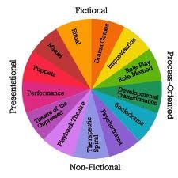
Drama therapy is an active, experiential approach that facilitates the client's ability to
^{tell his/her story}
^{solve problems}
^{set goals}
^{express feelings appropriately}
^{achieve catharsis}
extend the depth and breadth of inner experience
improve interpersonal skills and relationships
strengthen the ability to perform personal life roles while increasing flexibility between roles.
Drama Therapy is much more common in the United Kingdom but, is becoming more popular in the United States

Slide 4
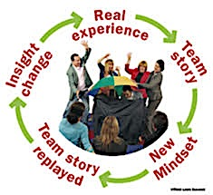
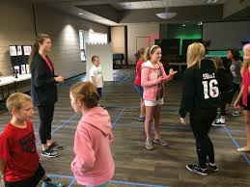
Who Can It Help
Dramatherapy is used in a wide variety of settings, including hospitals, schools, mental health centers, prisons, and businesses.

Slide 5
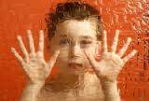
Children and Adolescents
Stories may be “played” using objects (such as puppets, dolls, or other toys) using one’s body, or using one’s voice
The result is an experiential process that draws on the child’s capacity for play
Drama therapists also assess children who need additional services and can make appropriate referrals.
With child and adolescent populations, dramatic techniques can help clarify, communicate, and define a child’s feelings

Slide 6
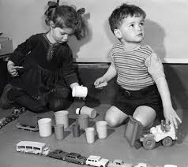
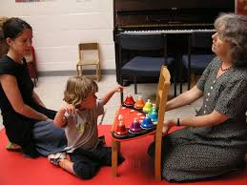
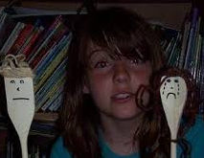
Some specific benefits of using drama therapy with children include:
reducing feelings of isolation
developing new coping skills and patterns
broadening the range of expression of feelings
experiencing improved self-esteem and self-worth
increasing sense of play and spontaneity
developing relationships.
According to Erikson and other theorists, play allows children to gain mastery over conflicts and anxieties.

Slide 7
The Addicts Population
When applied to those suffering from addictions, drama therapy provides chemically dependent clients with an opportunity to safely practice the behaviors necessary for abstinence
clients can openly
express emotions
explore a drug-free future
develop communication skills
make personal connections
practice honesty.
Clients can act out negative behaviors, such as drug-seeking, and consider their harmful impact, without consequences.
Clients are urged not to rationalize or deny addiction; rather, through the dramatic process, they are challenged to face their issues directly and truthfully.

Slide 8
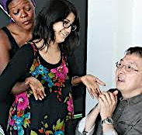
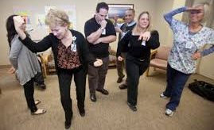
Clients have the opportunity to practice new skills, such as refusing drugs, and to imagine and take on new roles
Techniques such as role- play and improvisation offer a fresh perspective on behaviors, choices, and relationships.
Clients explore and develop their innate strengths through theatrical techniques that offer the distance necessary to consider their addiction (and resulting issues) without feeling overwhelmed.
Drama therapy, said one client, “gave me a way to have excitement in my life without the use of drugs. I can have fun being me without having to put on a mask.”

Slide 9
The Geriatric Population
Drama Therapy for the elderly
maximizes the person’s cognitive and communication skills
fosters creativity and individuality
encourages physical activity
builds community
strengthens self- esteem
Drama therapy also provides the means to create a graceful closure to the final stage of life development
theatre games, enactments, storytelling and poetry
Drama therapy provides a venue for reminiscing, life review, opportunities to acknowledge life’s achievements and possible conclusion for what is incomplete and needs to be finished.

Slide 10
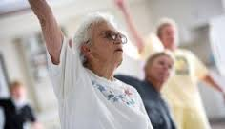
For persons with dementia, the therapist may use
dolls
puppets
hats
scarves
photos
copies of artwork
or sensory devices to evoke memories or encourage residents to use their imagination to create and enact stories.
Through use of sound and movement, drama therapy can provide a means of communication and connection for persons who have lost capacity for speech or clear verbal communication

Slide 11
What is A Drama Therapist
A Registered Drama Therapist (RDT) is a Master’s level credential requiring coursework in
psychology
drama therapy
experience in theater
supervised internship
work experience
RDTs are board certified in the practice of drama therapy and follow the NADTA (North American Drama Therapy Association) Code of Ethics.

Slide 12
Educational
Requirements
Master's or Doctoral degree in Drama Therapy from a program accredited by the National Association for Drama Therapy
OR
A Master's or Doctoral degree in theater or a mental health profession with additional in-depth training in drama therapy via NADTA's alternative training program.

Slide 13
Accredited Schools & Alternative Training Programs in the United States
California institute of Integral Studies (CIIS): San Francisco
Accredited since 1991
Concordia University: Montreal, Quebec, CANADA
Accredited 2000
Lesley University: Cambridge, MA
Accredited since 2014.
New York University: New York, NY
Accredited since 1989
Antioch University (Seattle, WA)
Center for Living Arts (Oakland, CA)
Creative Alternatives of New York (New Yok, NY)
Creative Clinical Consulting (Chicago, IL)
Drama Therapy Institute of Los Angeles (Los Angeles, CA)
Institute for Developmental Transformations (New York, NY / San Francisco,CA)
Kansas State University (Manhattan, KS)
Nova Southeastern University (Ft. Lauderdale, FL)
Omega Transpersonal Drama Therapy (Boston, MA)
Presence Center for Applied Theatre Arts (Charlottesville, VA)
Rehearsals for Growth (RfG) (Leverett, MA)
Soul Studies Institute (Stuart, FL)

Slide 14
Related Sites
American Art Therapy Association (AATA)
American Dance Therapy Association (ADTA)
American Society of Group Psychotherapy & Psychodrama (ASGPP)
American Board of Examiners in Psychodroma, Sociometry and Group Psychotherapy
American Music Therapy Association (AMTA)
The Drama Therapy Fund
International Association for Play Therapy (IAPT)
International Expressive Arts Therapy Association (IEATA)
National Association for Poetry Therapy (NAPT)
National Coalition of Creative Arts Therapies (NCCATA)

Slide 15
The Experience
https://www.youtube.com/watch?v=p_xyy_YN-QU
https://www.youtube.com/watch?v=CwacYiATS-E
https://www.youtube.com/watch?v=OVy58X0C3Jk
https://www.youtube.com/watch?v=F-HAsTr2LO4

Slide 16
Works Cited
"North American Drama Therapy Association." NADTA, n.d. Web. <http%3A%2F%2Fwww.nadta.org>.
N.p., n.d. Web. <http%3A%2F%2Fwww.youtube.com%2F>.
Badth.org.uk. "BADTH." British Association of Dramatherapists, n.d. Web. <http%3A%2F%2Fbadth.org.uk%2Fdtherapy>.
GoodTherapy.org. "Helping People Find Therapists and Advocating for Ethical Therapy." GoodTherapy.org, 25 June 2014. Web. <http%3A%2F%2Fwww.goodtherapy.org%2Fdrama-therapy.html>.
AGCAS Editors. "Dramatherapist Job Description." AGCAS & Graduate Prospects Ltd, Dec. 2014. Web. <http%3A%2F%2Fwww.prospects.ac.uk%2Fdramatherapist_job_description.htm>.

